Slide 1
Assessment, Evaluation, and Programming System (AEPS)
Sophie Hubbell, M.A.T
Kent State Universitysophiehubbell@yahoo.com

Slide 2
Agenda
  Part I
    Introductions
    Q&A, Goal Setting
    AEPS Quick Tour
    Assessment Component
  Part II
    Assessment Component Continued
      Scoring and Sumarizing
    Curriculum Component
      Sorting and Prioritizing for Tiered instruction

Slide 3
What is the AEPS Anyway?
=Assessment
=Evaluation
=Programming
=System
Notes:
3

Slide 4

AEPS 4 Volume Set
http://www.brookespublishing.com/store/books/bricker-aeps/index.htm
Notes:
4

Slide 5

AEPS Interactive (AEPSi)
Secure, web-based tool
Allows for easy means to record, score, track, aggregate, archive, and report on the results of the AEPS Test
http://aepsinteractive.com
http://www.aepsi.com

Slide 6
Assessment

Slide 7
The AEPS is an authentic assessment….
“Authentic assessment refers to the
systematic recording of developmental
observations overtime about the naturally
occurring behaviors of young
children in daily routines by familiar and
knowledgeable caregivers
in the child’s life.”
(Bagnato & Yeh Ho, 2006)

Slide 8
Authentic Assessment in Plain English
Familiar people….
In familiar settings…
With familiar objects/toys….
Doing familiar things.

Slide 9
Gather Information
Purpose is to guide instruction for diverse learners, some with known disabilities and concerns
Authentic Comprehensive
Interest and Preferences
Family priorities and concerns

Slide 10
Uses
Developing IFSPs/IEPs
Planning instruction
Monitoring performance over time
Eligibility
OSEP Accountability
http://aepslinkedsystem.com

Slide 11

Nuts and Bolts - CODRF
Levels
  Birth to Three (Level I)
  Three to Six (Level II)
Covers six broad developmental areas
  Fine Motor
  Gross Motor
  Adaptive
  Cognitive
  Social-Communication
  Social
Divided into strands, goals, and objectives
Notes:
11

Slide 12

Notes:
12

Slide 13
Organizational Structure of AEPS® Items
AREA
    STRAND A
STRAND B
Goal 1
Goal 2
Goal 3
Goal 1
Goal 2
Obj. 1.1
Obj. 2.1
Obj. 3.1
Obj. 1.1
Obj. 2.1
Obj. 1.2
Obj. 2.2
Obj. 3.2
Obj. 1.2
Obj. 2.2
Obj. 1.3
Obj. 2.3
Obj 2.3
Strands: Easy to More Difficult
Goals: Easy to More Difficult
Objectives become more difficult as the goal is approached.
Notes:
13

Slide 14
Difficult!
Easy!
Strand A
Strand B
Strand C
Goal 1
Goal 2
Goal 3
Objective 3
Objective 2
Objective 1
Notes:
14

Slide 15
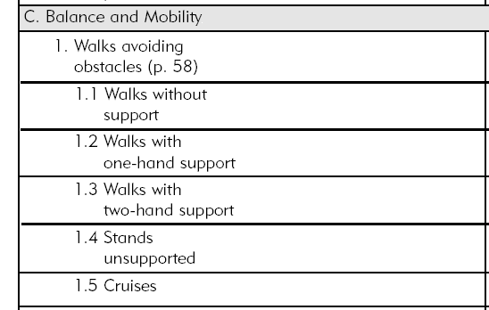
Gross Motor Sample
Notes:
15

Slide 16
Assessment Activity Plans
Support embedding AEPS test items into daily activities
Designed to support assessment across developmental areas
Provide opportunities for children to demonstrate the range of their skills while actively engaged
Provide opportunities to collect assessment information on several children at one time
Provide opportunities for teams to observe children
Designed to assess a single child in multiple areas or multiple children within and across areas.
Generic enough to support different themes, materials, locations
Notes:
16

Slide 17
Assessment Activity Plans
AEPS comes with 12 pre-written activities to assess a variety of children across developmental areas (see volume 2)
Can create your own that parallel existing planned activities or those provided in the AEPS.
AEPSi contains 15 inclusive assessment activities
  8 center-based
  7 home-based
Notes:
17

Slide 18
Family Report
2 Levels (birth to three and three to six)
  2 sections
    Family Routines (Section 1)
    Family Observations (Section 2)
  Quantitative and Qualitative Information
Family information is critical to help guide the development of the IFSP/IEP and subsequent intervention
Notes:
18
IDEA says that families are to be involved in all aspects of their child’s educational program, including assessment and program development.
Remind participants that family involvement is necessary for obtaining accurate information regarding children's development.
The AEPS Family Report offers a strategy for ACTIVELY involving families in the assessment and program development process.
Section I of the Family Report may be more useful in making recommendations to the IFSP team and/or for a service coordinator to complete prior to an IFSP meeting. Section I is a set of open ended questions about different activities in which the family and child spend time (e.g., meals, community activities, bathtime). Essentially, families answer questions about what is going well about the activity and what parts of the activity are difficult for the activity. This is excellent information for IFSP/IEP development. Service providers should know how to interpret families concerns (i.e., those things that families are anxious about) and help families turn those concerns into needs statements (i.e., what the team can take action on to address the concern). For example, if a family says that they are struggling with taking their child to restaurants because the child has tantrums, the teachers should explore possible reasons. Does the child have no way to communicate his preferences? Do the large crowds seem to bother him? Does he have difficulty managing a food tray with his meal on it? Depending on the problem, the teacher might suggest addressing communication, social or adaptive skills (i.e., needs) that might make dining out a better for the family (i.e., their concern).
Section II of the Family Report (Spanish and English) contains only the goals form the AEPS Test Level I (except for additive goals – then objectives are included as well).
Users are reminded to consider language, reading, and time as barriers to family participation. Be clear on the purpose for asking the information and how the information will be used.

Slide 19
Family Report
2 Levels (birth to three and three to six)
  2 sections
    Family Routines (Section 1)
    Family Observations (Section 2)
  Quantitative and Qualitative Information
Family information is critical to help guide the development of the IFSP and subsequent intervention
Notes:
Sample portions of the AEPS Family Report (HO)
Trainers are encouraged to reach Chapter 5 of Volume 1 to learn more about how to use the family report.
Remind participants that family involvement is necessary for obtaining accurate information regarding children's development.
Section I of the Family Report may be more useful in making recommendations to the IFSP team and/or for a service coordinator to complete prior to an IFSP meeting.
Section II of the Family Report (Spanish and English) contains only the goals form the AEPS Test Level I (except for additive goals – then objectives are included as well).
Users are reminded to consider language, reading, and time as barriers to family participation. Be clear on the purpose for asking the information and how the information will be used.

Slide 20

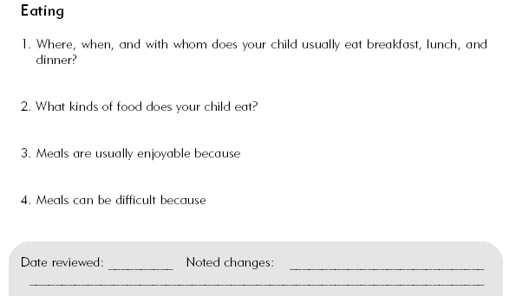

Slide 21

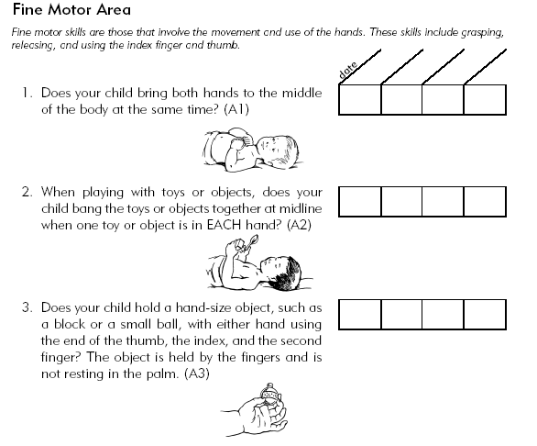
Notes:
Families/caregivers are asked to rate each item (each goal) as Yes (2), Sometimes (1), or Not Yet (0). The team may need to indicate or illustrate which items they would not expect a child to yet perform based upon their CA.

Slide 22
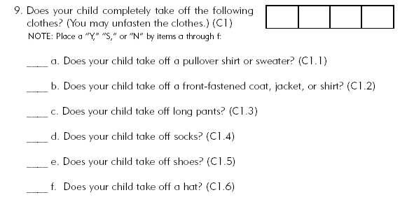

Slide 23
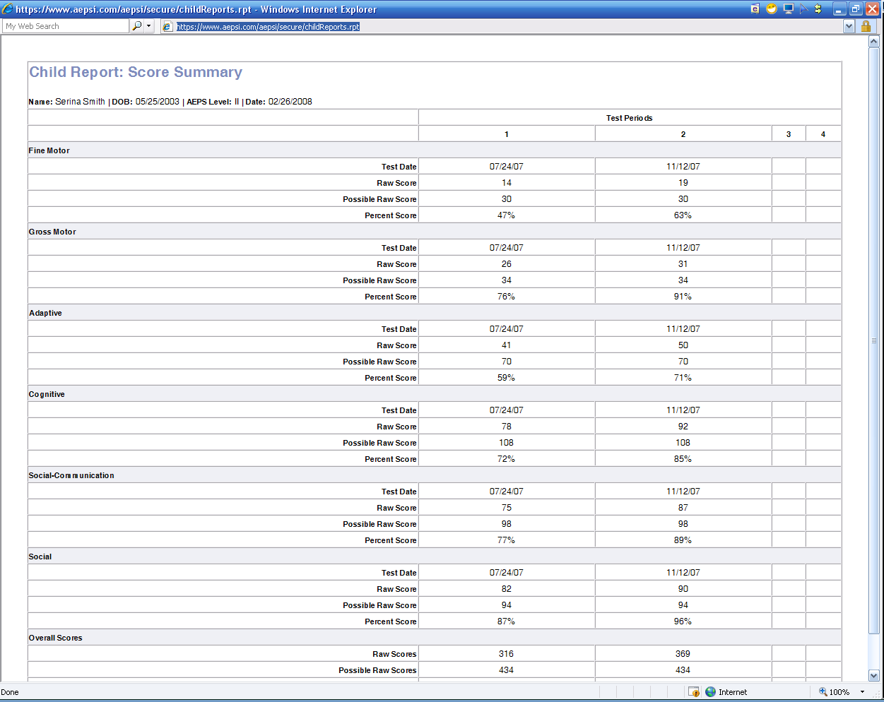
Notes:
23

Slide 24
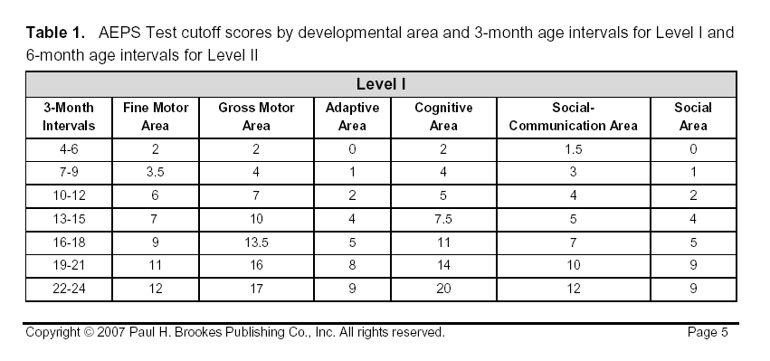

Slide 25
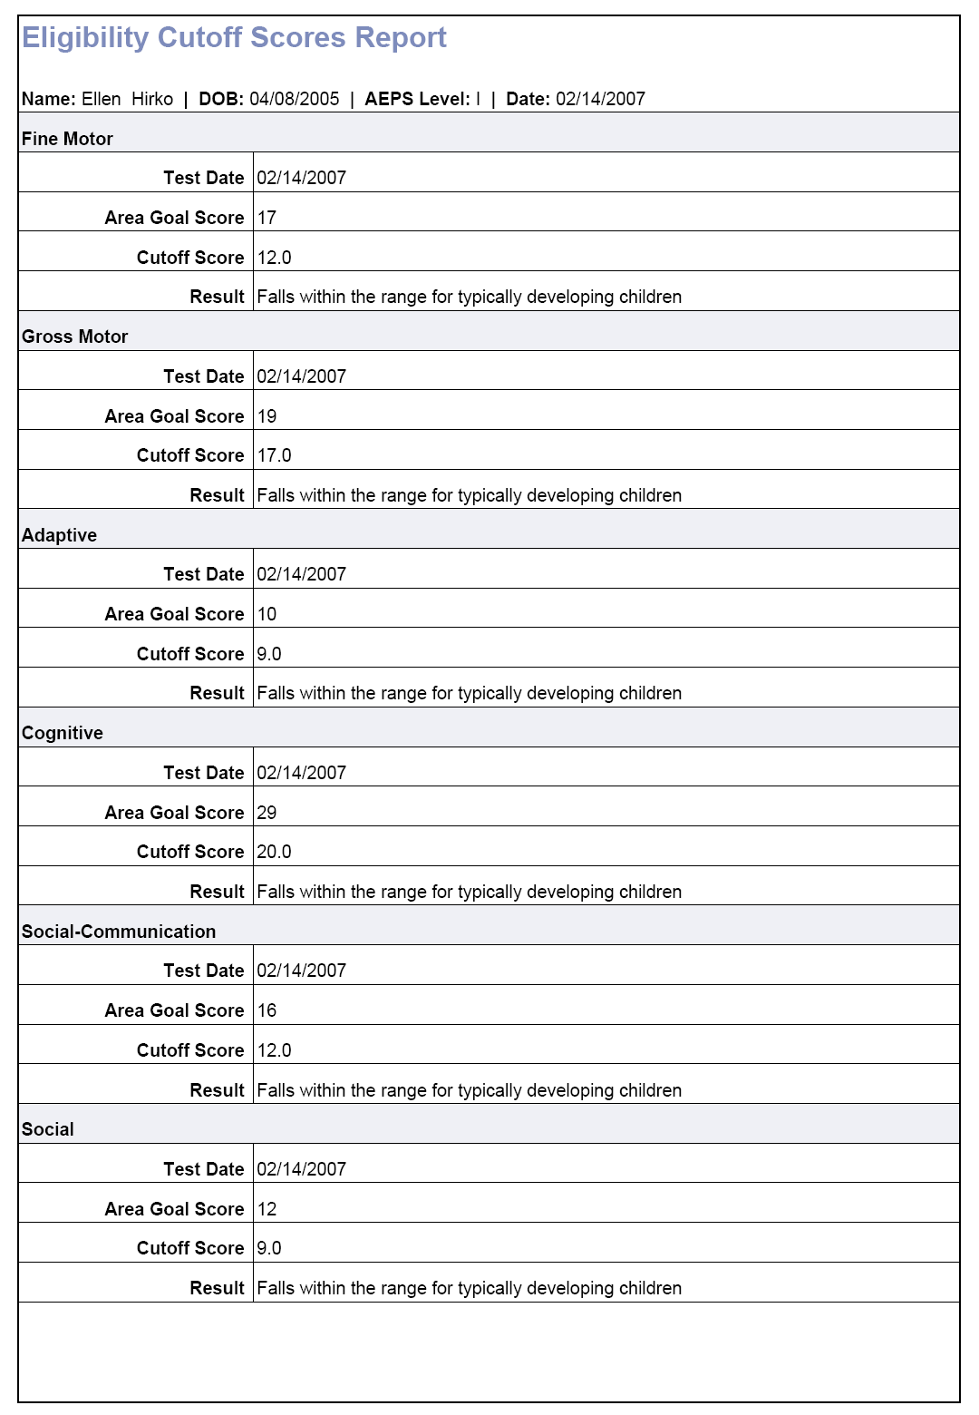

Slide 26
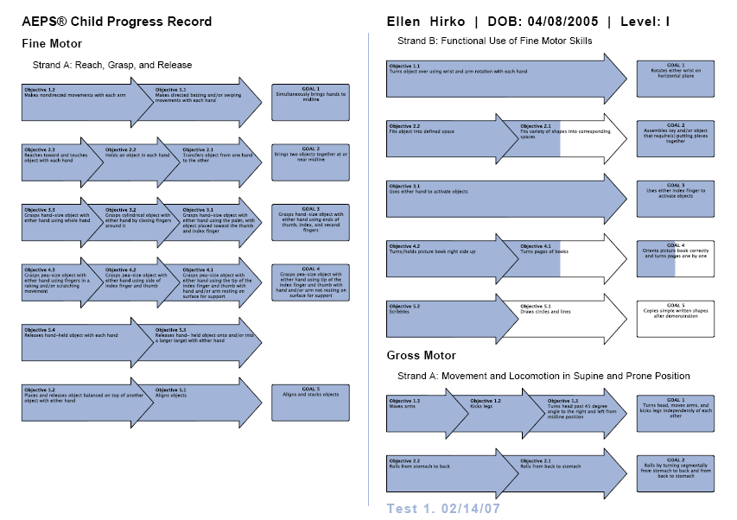
Notes:
26

Slide 27
Going Beyond the Numbers
AEPS information can be summarized visually and narratively as well
Visit http://aepsblog.blogspot.com to download a series of podcasts related to summarizing the AEPS
All types of summaries have pros and cons
Consider your purpose and audience
Consider multiple means of representation
Notes:
27

Slide 28
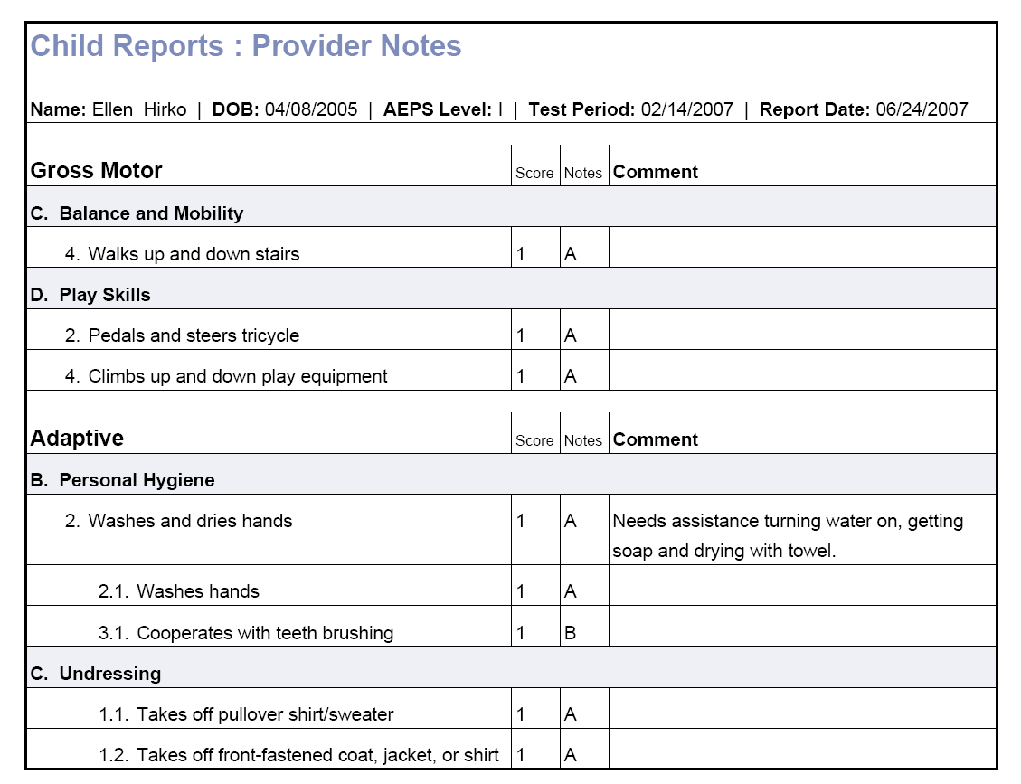
Notes:
28

Slide 29
Volume 1
Introduction to the AEPS
The AEPS: An Overview
Linking
Content & Organization
Using AEPS Test
Family Participation
A Team Approach
Psychometric Properties
IFSP/IEP Examples
Data Recording Form
Family Report
Child Progress Record
VOLUME 1
AEPS®
Administration
Guide
Notes:
Key features:
Chapter 3
Forms (appendixes C, D, and E)
Appendix F is dated and should not be used (refer to IN eligibility manual instead)

Slide 30
Volume 2
How to Use Volume 2
Purpose and Value of
Assessment & Evaluation
Using the AEPS Test
Data Collection
AEPS Test Items
Assessment Activities
VOLUME 2
AEPS®
Test
Level I and II with
criteria
Notes:
Must have access to the criteria:
CODRF with criteria
Volume 2
AEPSi
Sample assessment activities (more in AEPSi)

Slide 31
Volume 3
VOLUME 3
AEPS®
Curriculum for Birth
to Three
Introduction
Understanding the Curriculum
Using the AEPS Curriculum
Designing and Implementing
AEPS Curriculum
Routine Activity Format I: An Activity Targeting Goals from Multiple Areas
Routine Activity Format II: Multiple Activities Targeting Goals from One Area
Planned Intervention Activities
Notes:
Link to intervention – ideas for providers and family members
Rationale for why various skills and concepts are important to young children

Slide 32
Volume 4
Understanding the Curriculum
Using the AEPS Curriculum
Designing and Implementing
AEPS Curriculum
Ideas for Planned Intervention Activities
Completed Examples of Planned Intervention Activity Forms
VOLUME 4
AEPS®
Curriculum for
Three to Six

Slide 33
Overview of Forms
Child Observation Data Recording Form (Appendix C Vol 1)
Family Report (Appendix D Vol 1)
Child Progress Record (Appendix E Vol 1)
Assessment Activity Plans (Appendix A Vol 2)
Social Communication Forms (Appendix C Vol 1)
  Social Communication Observation Form
  Social Communication Summary Form
Child Observation Data Recording Form with Criteria (sold separately)
Notes:
All forms except the CODRF with criteria are found in Volume 1 or are sold a separate forms. The CD-ROM has all forms including the CODRF with criteria. The AEPSi also has all forms.

Slide 34
Stop and Consider
How is the AEPS Test organized?
  What are areas, strands, goals, and objectives?
  How are items ordered?
How do you gather information about a child’s performance for the AEPS Test?
How are items scored?
Where do you begin? Where do you end?
Do you need to gather information and score every AEPS Test item from every area?
Notes:
34
Look at … think about video from earlier

Slide 35
What to do with AEPS® results?
Decide which direction to head
Summarize
Interpret findings
Select meaningful skills
Ongoing monitoring

Slide 36
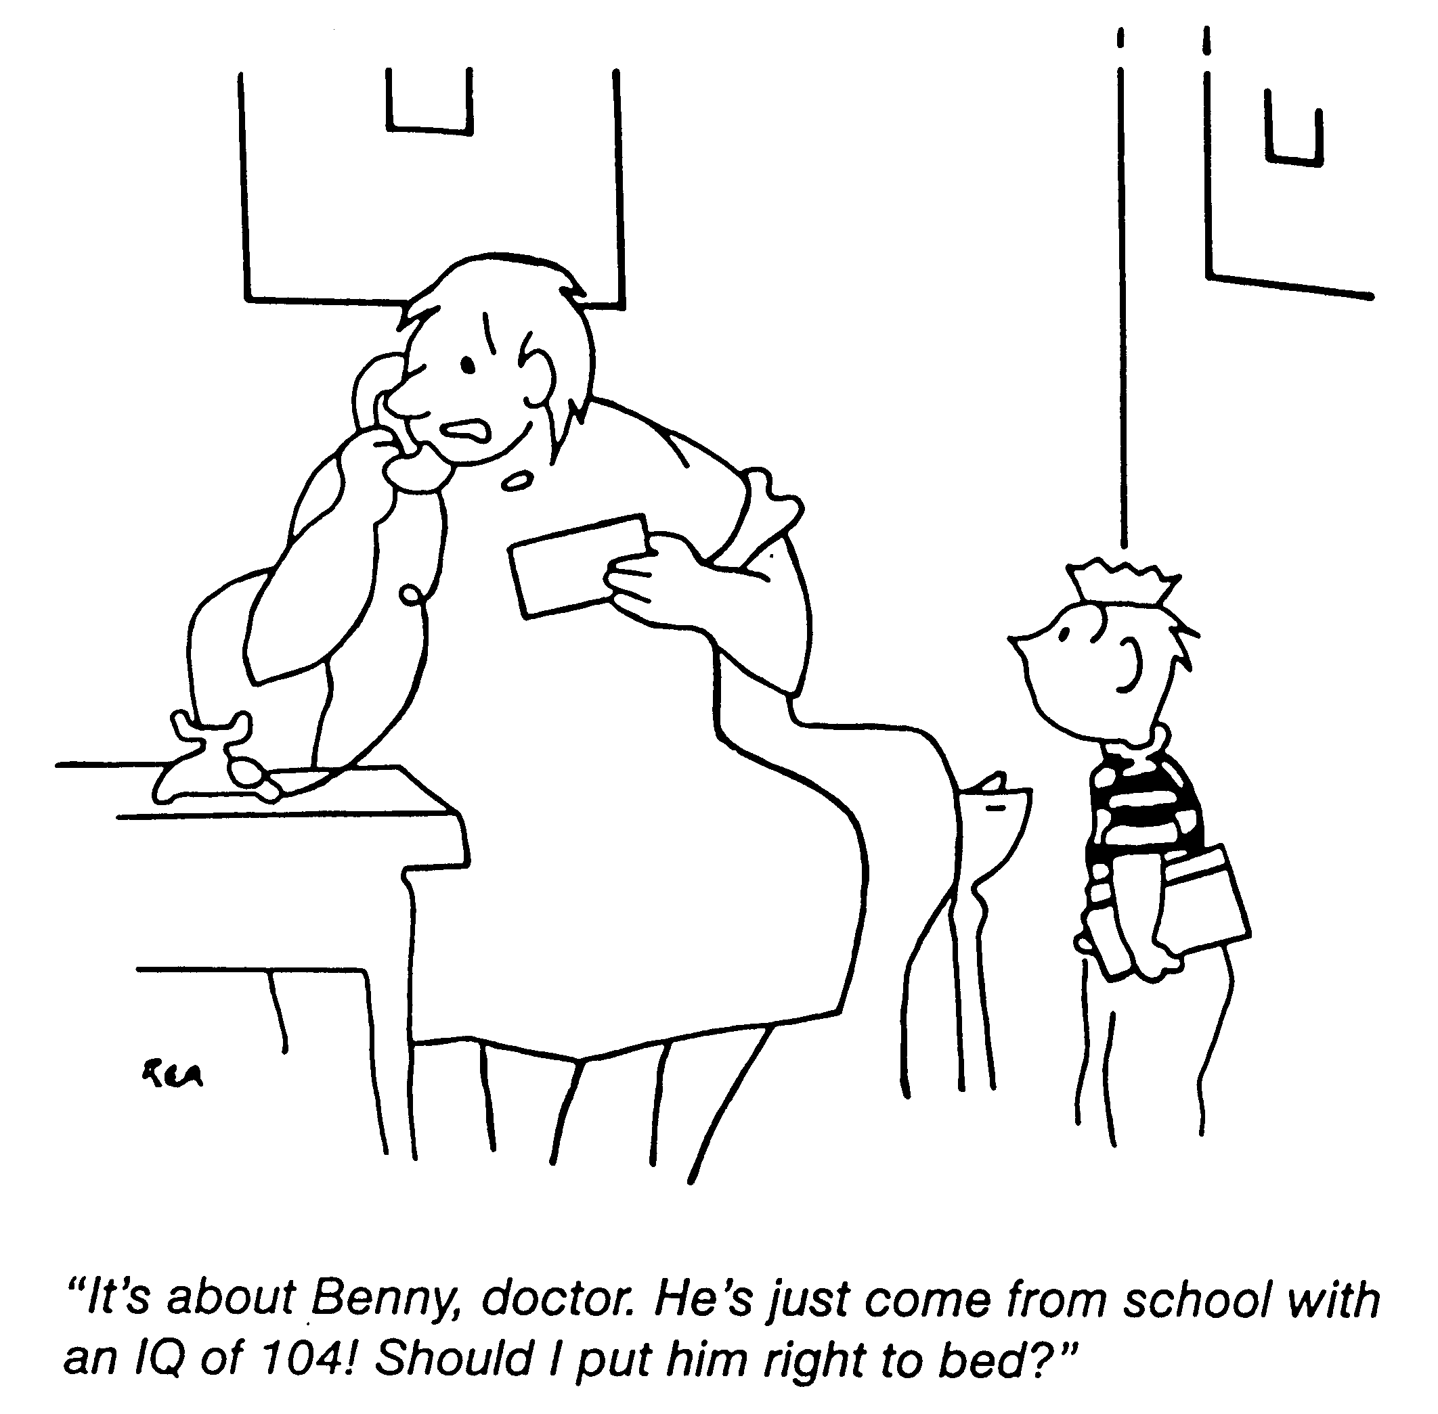
Notes:
Comic Relief
The mom is interpreting IQ as temperature – use as a warning to folks that the AEPS numerical summaries can also be misunderstood.

Slide 37
Summarizing AEPS Results
Numerical
  Area Percent Scores
  Total Percent Scores
  Percent of area - independent v. emerging
Visual
  Graphing
  Child Progress Form
Narrative
Notes:
There are three primary ways AEPS Test information can be summarized.
Remind participants that you are not yet discussing interpretations and reports for eligibility.

Slide 38
Types of Scores
Area Percent Score
  Add 2’s and 1’s =Area Raw Score
  Divide by the Total Area Score Possible
Total Percent Score
  Add 2’s and 1’s across areas = Total Raw Score
  Divide by the Total Score Possible for all areas

Slide 39
Number of Items Per Area and Area Raw Score Possible on the AEPSTM Test for Birth To Three Years and Three To Six Years
Area
Number of Items
Area Raw Score Possible
AEPS Test for
Birth to Three Years
AEPS Test for
Three to Six Years
AEPS Test for
Birth to Three Years
AEPS Test for
Three to Six
Years
Fine Motor
33
15
66
30
Gross Motor
55
17
110
34
Adaptive
32
35
64
70
Cognitive
58
54
116
108
Social-Communication
46
49
92
98
Social
25
47
50
94
Total Number of Items
249
217
Total Raw Score Possible
498
434

Slide 40
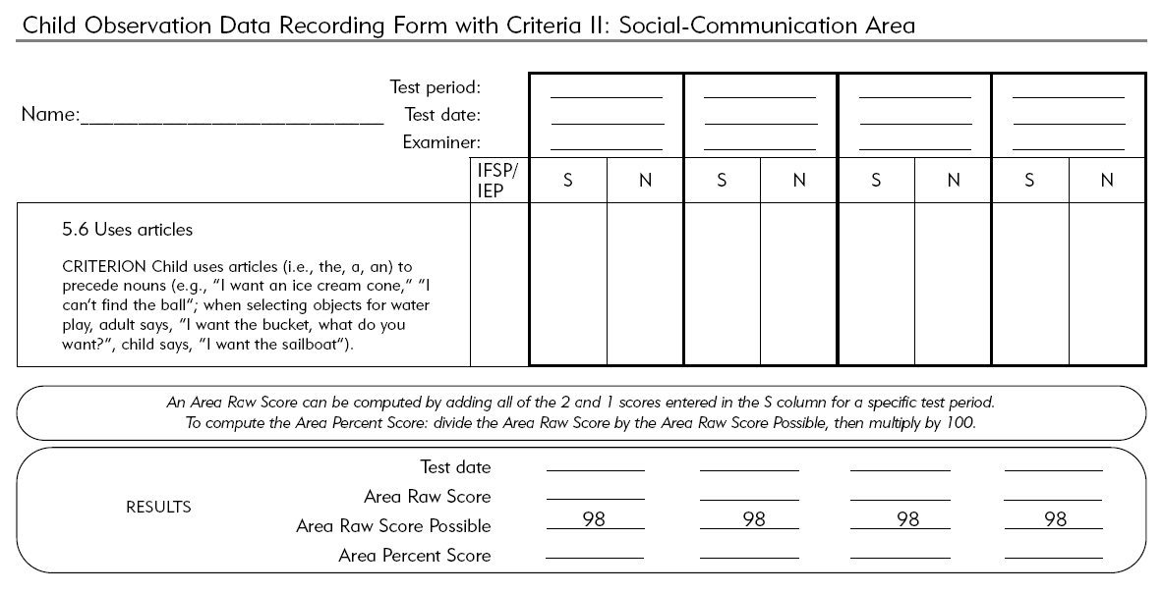
Numerical Scores using AEPS Protocols
Notes:
Sample of the CODRF
Each CODRF ends with a results section for each area of development
Have participants return to the Gross Motor CODRF and in the 2nd Score column randomly put 2,1,0s, or ask them to score for a child who they know well. Remind them that if a goal is a 2 they can assume and place a score of 2 for each of the subsequent objectives. Make sure they don’t put the score in the IFSP/IEP column and that each item has a single score (sometimes the criterion falls over to the next page). They should then sum all the scores in column 1 and place the area raw score in the results. Using a calculator have them divide the raw score by the area raw score possible, multiply by 100, and determine the Area Percent Score.

Slide 41
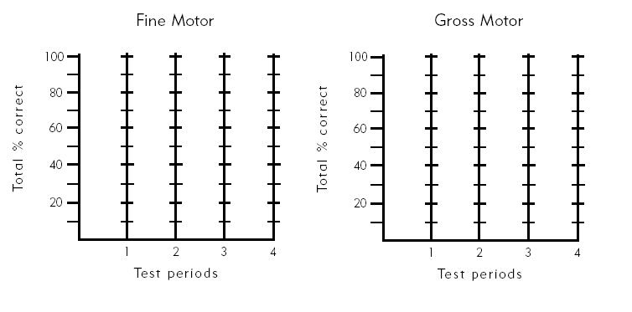
Graphing
Notes:
Graph (HO)
Participants can take the GM Area percent score and place it on the graph or just share that the graph is one way to visually share AEPS test results.
The whole AEPS for a given area must be completed to generate the an area percent score.

Slide 42
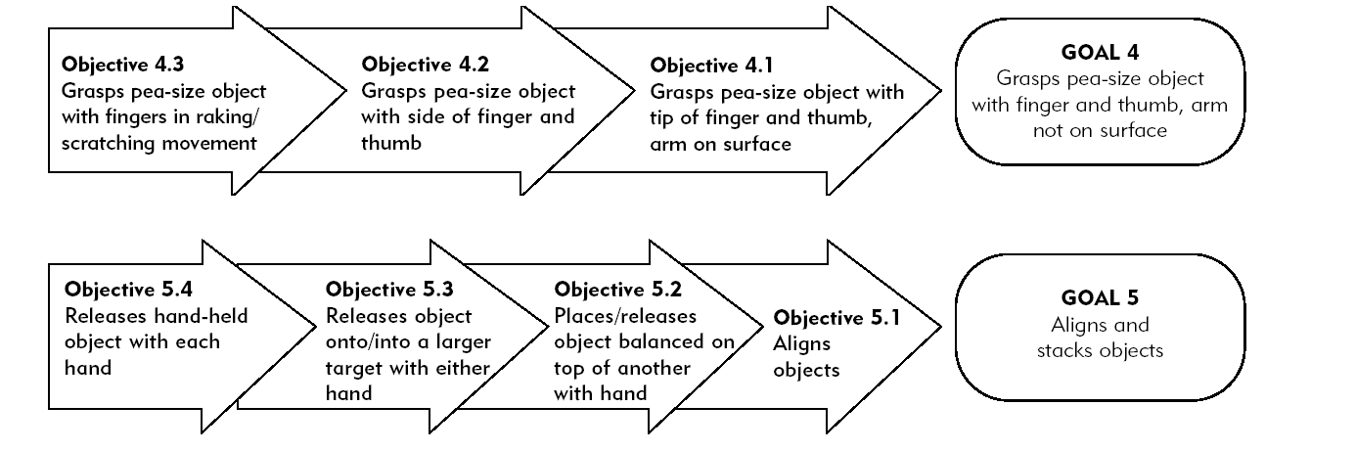
Child Progress Record
Notes:
Sample Portion of the Child Progress Record (HO)
The Child Progress Record is found in Appendix E of Volume 1, the AEPS CD-ROM, sold as a separate form, and found within the AEPSi.
How to complete and use the Child Progress Report is discussed in Chapter 3 of Volume 1; however, teams are encouraged to shade objects fully when a child receives a score of 2, part way or with hash marks when they receive a score of 1, and to leave blank when the child receives a score of 0.
A key may need to be created.

Slide 43
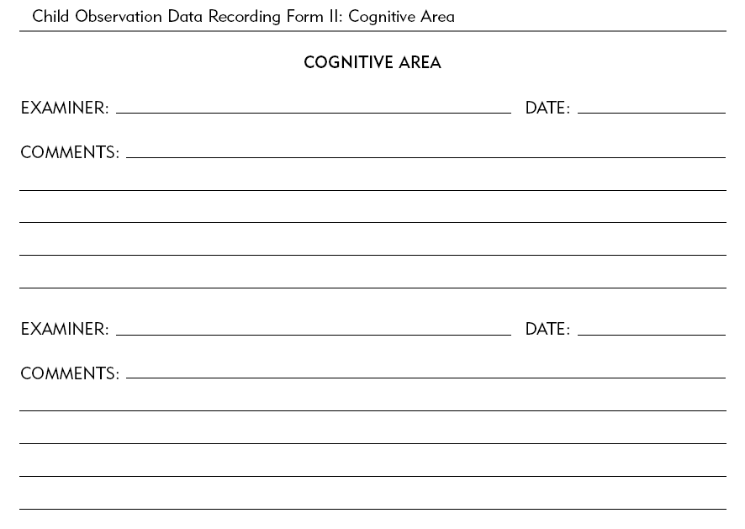
Using AEPS Narrative Info
Notes:
Narrative or running comments can be recorded in the comments section, a scratch piece of paper, or the AEPSi. Comments are used to explain scoring notes or other key observations.

Slide 44
AEPS Eligibility Cutoff Scores
Appendix F of Vol. 1 pg. 299
  Bricker, D., Yovanoff, P., Capt, B., & Allen, D. (2003). Use of a curriculum-based measure to corroborate eligibility decisions. Journal of Early Intervention, 26(1), 20-30.
  Overall Only
  Goals Only
  Scores of 2 or 0 Only
Notes:
Historically speaking this is where we began in terms of using the AEPS for eligibility.
Appendix F is being updated and will be sent out and made available for no cost to all users.
Scores contained in Appendix F of Volume one have been discussed in JEI.

Slide 45
AEPS Eligibility Cutoff Scores Continued
AEPSi
  Cutoff scores by area (both levels)
  Cutoff scores by 3 month intervals (level I)
  Cutoff scores by 6 month intervals (level II)
Paper pencil
  Replacement to Appendix F (forthcoming)
  Paper on using the AEPS for eligibility (forthcoming)
Notes:
More context in the sense that the AEPS does exist in a larger context than how it is being used in IN and participants may have questions about the AEPSi etc.
Scores that are now being used and that are found in the IN eligibility manual have the following characteristics:
3 month age intervals for Level I
6 month age intervals for Level II
Eligibility cutoff scores are not provided for the 67–72 month interval because sufficient data were not available to derive valid cutoff scores .
Scores are provided for each developmental area.
Sum only the goals for each area.

Slide 46
Determining Eligibility for
First Steps
Step One: Select Appropriate Level of the AEPS® Test to Administer and Score
Step Two: Administer and Score the Chosen Level of the AEPS® Test
Step Three: Calculate Area Goal Scores
Step Four: Determine Eligibility Status
Notes:
Steps (HO)
Review the four steps to determining eligibility for First Steps
Generate case examples, share experiences, and/or engage in large group discussion as needed.

Slide 47
Interpreting
Summarize data
Make comparisons
Consider related factors
Make decisions and share findings
Notes:
Regardless of purpose (eligibility, programming, progress monitoring, accountability), teams should summarize AEPS data, make comparisons to existing cutoff scores or benchmarks, compare to other sources of information, compare to developmental norms, consider related factors, and make a team decisions.

Slide 48
PART 2

Slide 49
Scoring Option: 2
Consistently performs as specified in the criterion
Performs the item independently
Behavior is a functional part of the child’s daily routine
Child uses the skill across time, materials, settings, and people
Notes:
49

Slide 50
Scoring Option: 1
Performs the skill inconsistently as specified in the criterion
Performs the item with assistance
Performs only parts of the stated criterion (i.e., the skill is emerging)
Performs the item under specific situations or conditions
Notes:
50

Slide 51
Scoring Option: 0
Does not yet perform the item as specified in the criterion even with repeated opportunities or assistance or when modification are made
Child was not observed performing the item because it is not expected based upon knowledge of development
Notes:
51

Slide 52
Scoring Note Options
A = Assistance (1 or 0)
B = Behavior Interfered (1 or 0)
R = Report (2, 1, 0)
M = Modification (2, 1, 0)
D = Direct Test (2, 1, 0)
Q = Quality (2, 1)
Notes:
52

Slide 53
What Additional Information Do Scoring Notes Provide?
A = Assistance (1 or 0)
  Environment, peer, or adult performs part of the criterion
B = Behavior Interfered (1 or 0)
  Refusal, ignore, inattention, aggression
R = Report (2, 1, 0)
  Haven’t recently reviewed the criteria; other sources
M = Modification (2, 1, 0)
  Long terms change of how child performs criterion; ensure assessment items are culturally, linguistically, and individually non-biased
D = Direct Test (2, 1, 0)
  Contrived/situated; repeated prompting/trials
Q = Quality (2, 1, 0?)
  Something unique or unusual but still functional
Notes:
53

Slide 54

Scoring Practice
In addition to scoring items, you are encouraged to use scoring notes (qualifying notes). What are they and how do you use them?
  Does every scored item require a note?
  Where do you record the score and/or the note on the Child Observation Data Recording Form?
Provide an example of how and when you would use each of the notes
Are you allowed to make modifications and adaptations of AEPS items?
  If yes, what is allowed?
  Provide a couple of examples of how you would modify or adapt an AEPS item
Notes:
54
Show GM video again

Slide 55
Scoring Guidelines
If either type of goal is a 2, then all associated objectives can be scored a 2
If and additive goal is scored a 0, then all associated objectives can be scored a 0.
If a developmental goal is scored a 0, then look at the next objective
  As soon as an objective is scored a 2, then all remaining objectives are scored a 2

Slide 56
Types of Scores
Area Percent Score
  Add 2’s and 1’s =Area Raw Score
  Divide by the Total Area Score Possible
Total Percent Score
  Add 2’s and 1’s across areas = Total Raw Score
  Divide by the Total Score Possible for all areas

Slide 57
Stop and Consider
Possible participant questions
  How can someone score a developmental area of the AEPS that is outside their area of training?
  Can I score goals that I didn’t actually observe?
  What do I do if information conflicts (e.g., one person says they can, one says they can’t, I saw the child do it one time and not another etc.)?

Slide 58
Types of Summaries
Numerical
  Area Percent Scores
  Total Percent Scores
  Percent of area - independent v. emerging
Visual
  Graphing
  Child Progress Form
Narrative

Slide 59
Curriculum

Slide 60
What is curriculum?

Slide 61
Professional Development
Leadership Plan
Data-Driven Decision Making
Progress Monitoring
Activities & Instruction
Assessment
Scope & Sequence
Collaborative Partnerships
Curriculum Framework

Slide 62
Ask…
“How can the daily activity address and support the needs of a diverse learner?”
Change the way we think…..
Instead of….“How might the daily activity need to be modified for the child?”
Notes:
62

Slide 63

How do we begin?
What is “IT” you wish to teach or a child to know?
Do we have a common understanding of “IT”? Anything related to “IT”?
Does your child have tier 2 needs related to “IT”?
Does your child have tier 3 needs related to “IT”?
What can your child do related to “IT”?
Notes:
Handout: Blank Counting Worksheet
63

Slide 64
Scope and Sequence
Prioritized Needs
Targeted
Needs
Common Needs
Notes:
From assessment summaries…. determine which child needs fall into which tier
Prioritized (require III instruction to create change, emphasis is on acquisition)
Targeted (emerging skills, temporary, conditional, require practice/exposure/maturation with support, emphasis is on generalization, use, fluidity)
Common (universal outcomes, generally agreed upon developmental expectations, concepts and skills will emerge when child is ready because they have prerequisites and the environment is supportive – provides learning opportunities)

Slide 65
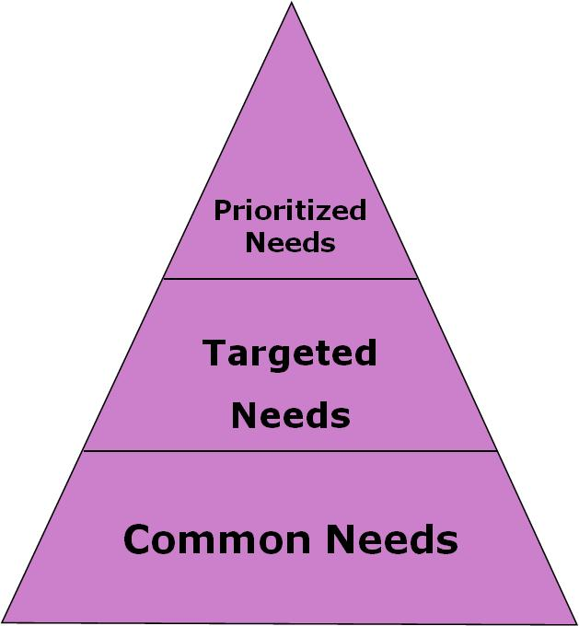
Assess
Tier 1 Needs
What common concepts and skills are to be covered/taught/addressed for all?
  Developmental domains
  Content areas
  State standards
  Federal outcomes
  ….Big Ideas
Notes:
65
65
65
State Support Team Region 8, May 2008

Slide 66
Scope and Sequence Continued
Sequence
  Developmental – typical or predicable sequence
    first learn to pull to a stand, then cruise, then walk with support, then walk unsupported
    first demonstrate an understanding of stable order, then one-to-one correspondence, and then cardinality
  Pedagogical - what is known about effective instruction/teaching
    rhyming supports introduction to phonological awareness, as rhyming skills become secure alliteration will be presented, followed by hearing separate phonemes in simple words, and then, letter/sound correspondence
  Logical –
    if a child is exhibiting challenging behaviors, it may be necessary to first teach/address the challenging behaviors before moving forward with instruction on other concepts and skills

Slide 67
Plan Instruction
Tiered model of instruction
  Tier 1
    Continual access
    Build upon interests
    Engaging
  Tier 2
    There when needed
    Spread the work load
    Remove as needed
  Tier 3
    Intensive
    Individualized
Notes:
67
State Support Team Region 8, May 2008

Slide 68
Outcomes Must Match
Instructional Intensity
Tier 3: Individualized, intensive, and intentional instruction
Tier 2: Targeted and temporary instruction
Tier 1: Universal instruction
Frequency and intensity of instruction increases
Non-directed
Mediated
Directed

Slide 69
Instructional Tier 1 Characteristics
Who: For all learners
What: Incidental to Directive
Why: Preventative
When: Constant
How: Environmental arrangement, universal design for learning, developmentally appropriate practices
Emphasis is on acquisition of tier one needs, exposure, generalization, and use

Slide 70
Instructional Tier 2 Characteristics
Who: For some learners
What: Incidental to Directive
Why: Scaffold/jumpstart learning
When: Temporary
How: Targeted
Emphasis is on supported practice, fluency, increased independence, and latency

Slide 71
Instructional Tier 3 Characteristics
Who: For select learners
What: Incidental to Directive
Why: Change/Growth
When: Distributed
How: Individualized ARC embedded into daily routines and activities
Emphasis is on acquisition of tier three

Slide 72
Prioritize
Developmentally appropriate?
  don’t supersede human development
Important for everyone?
  or only important to our values
Increase access, participation, and progress?
  avoid discrete skills
Functional for the child’s daily routine?
  avoid prioritizing future needs
Notes:
72
State Support Team Region 8, May 2008

Slide 73
Goal Writing
Measurable
Observable
Functional
Transferable
Meaningful
Notes:
73
State Support Team Region 8, May 2008

Slide 74
Progress Monitoring
Tier 3: Progress toward individualized outcomes
Tier 2: Progress toward targeted outcomes
Tier 1: Progress toward common outcomes
Progress monitoring practices vary in frequency, intensity, and intent

Slide 75

Tier 1
Annually
Quarterly
Tier 2
Repeated
Weekly
Tier 3
Minute by minute
Daily
Semi-Annually
Monthly
Hourly
Weekly
Notes:
75
75
State Support Team Region 8, May 2008

Slide 76
Interpret Patterns
Patterns of Strength
Unexpected Scoring Sequence
Patterns of Lack of Quality
Patterns of Assistance
Patterns of Behavior Interfering
Patterns of Direct Prompt

Slide 77

For this developmental goal – what do the scoring sequences tell you?
2 | 0 | 0 | 1 | 1 | 2
2 | 0 | 1 | 2 | 1 | 2
2 | 0 | 2 | 2 | 1 | 2
2 | 0 | 2 | 2 | 1 | 0
0
2
2
2
PG 195 Vol 2 Level 2 Social Strand A Goal 2
Notes:
77

Slide 78
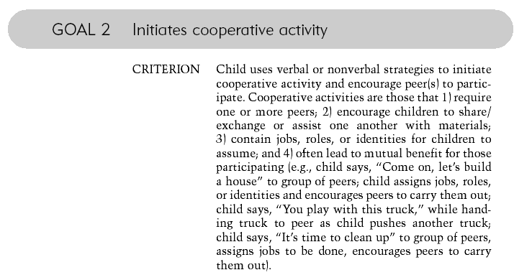
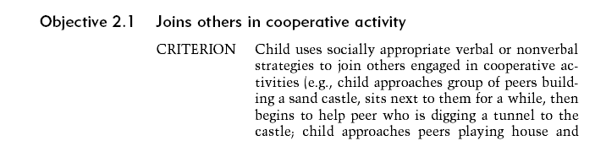
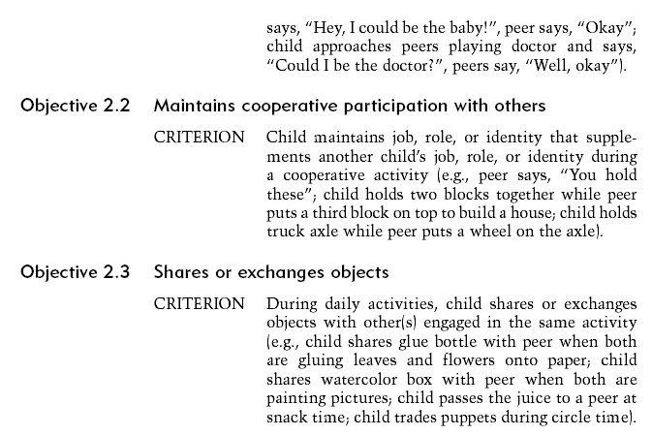
Notes:
Example of a developmental goal Level II, Social Area, Strand A

Slide 79
For this additive goal – what do the scoring sequences tell you?
2 | 0 | 1 | 1 | 1 | 1
2 | 0 | 1 | 2 | 2 | 0
2 | 0 | 1 | 1 | 0 | 2
2 | 0 | 1 | 2 | 1 | 0
1
0
0
1
PG 195 Vol 2 Level 2 Social Strand A Goal 1
Notes:
79

Slide 80


The criterion for the Goal is to do all 5 objectives as the situation arises
Notes:
Example of an additive goal from Level II, Social Area, Strand A

Slide 81
Tier 1 Scope
What common concepts and skills are to be covered/taught/addressed?
  Concepts and skills from developmental domains and content areas
  State standards
  Federal outcomes
Notes:
81
81
81
State Support Team Region 8, May 2008

Slide 82
Tier 2 Scope
Concepts and skills that are emerging (stalled but not missing)
Concepts and skills that are critical to a child’s ability to demonstrate what they know and can do
Components or portions of the larger concept or skill
Examples
  Non verbal expressions (e.g., writing)
  Participating within a variety of group settings (e.g., initiating cooperative play)
Notes:
82
82
82
State Support Team Region 8, May 2008

Slide 83
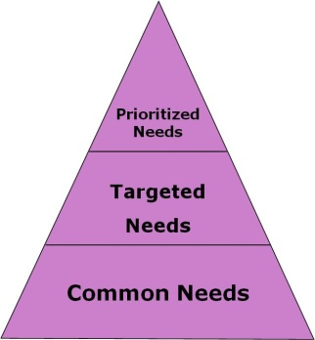
Tier 3 Scope
Concepts and skills that are keeping the child from accessing, participating, and making progress in the general curriculum/daily activities
  Barriers/Underlying issues
  Missing prerequisite or foundational skills
Examples
  Barriers, underlying issues or concerns (e.g., challenging behavior, quality of movement, intensity of action, another language)
  Foundational or prerequisite behaviors (e.g., joint attention, imitation, vocalizations, manipulation of objects, functional use of objects)
Notes:
83
83
83
State Support Team Region 8, May 2008

Slide 84
Sorting Example 1
Follows Social Routine
Remains with Group
Participation
Notes:
84

Slide 85
Prioritize
Consider past efforts
Consider family priorities
Consider needs vs. concerns (attitude or emotional mindset)
Consider notion of access, participation, and progress
Consider sequences
  Developmental (milestones)
  Pedagogical (how to teach)
  Logical (what makes sense)
For Tier 2 and for sure Tier 3
  Need must result from a disability/delay
  Need must have an adverse affect
  Need will be addressed this year
  Need requires specially designed instruction

Slide 86
Strengths
Needs
Solutions
Priorities/Goals/Outcomes

Slide 87


Slide 88
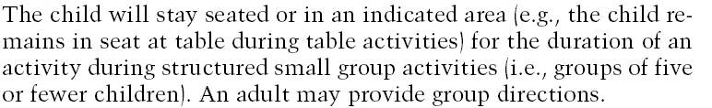

Slide 89
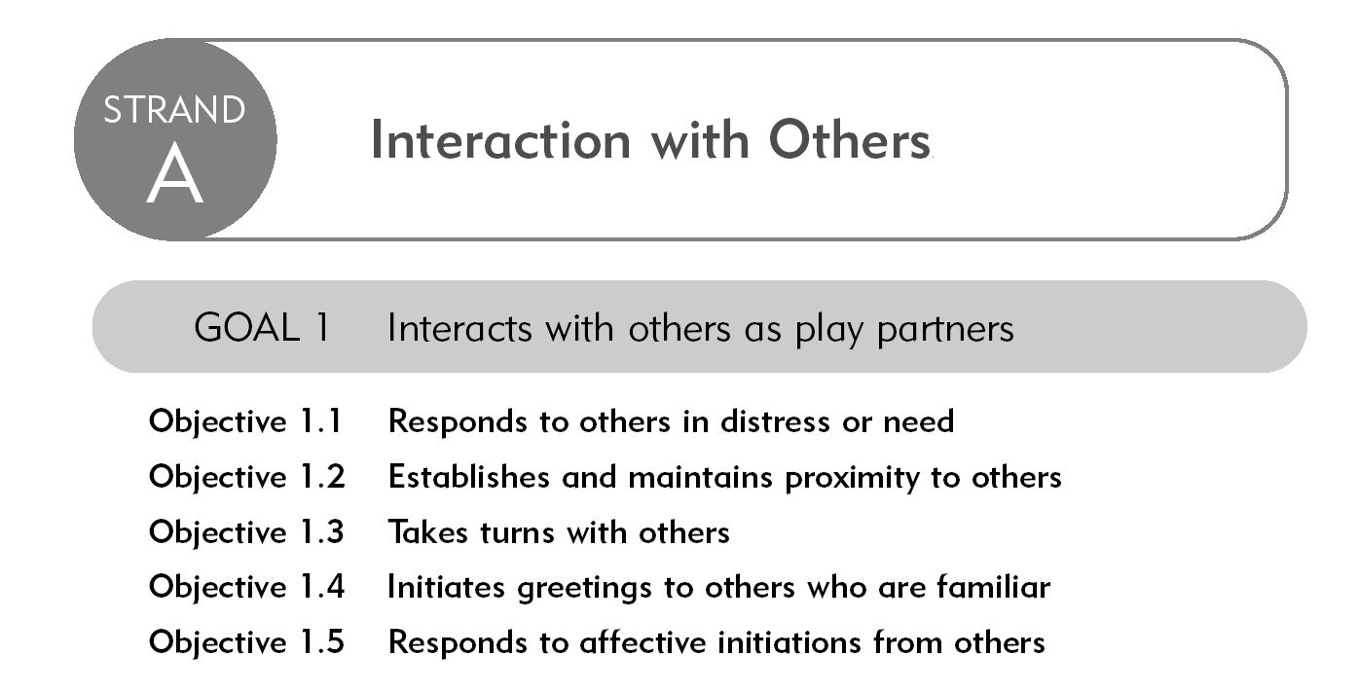
Notes:
89

Slide 90
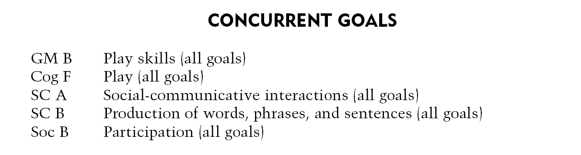
Notes:
90

Slide 91
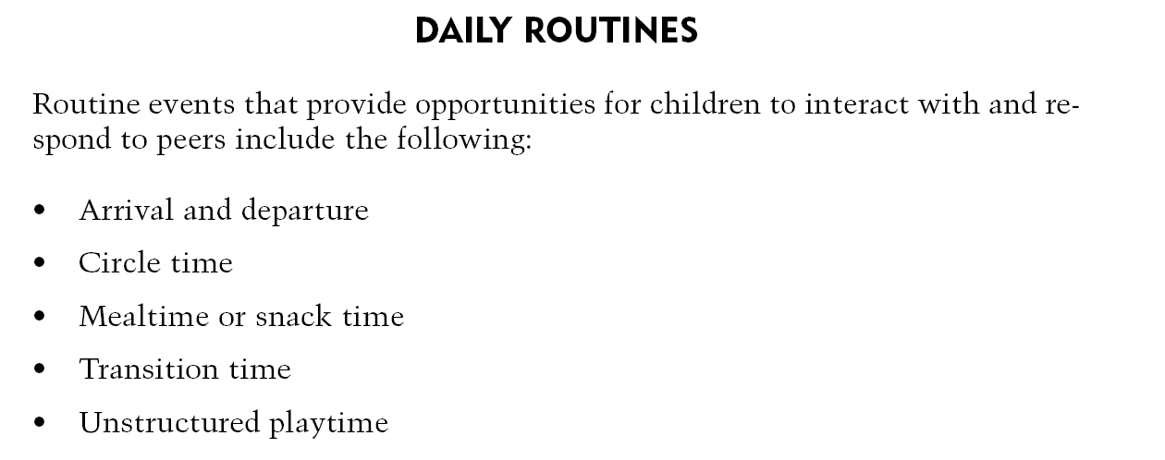
Notes:
91

Slide 92
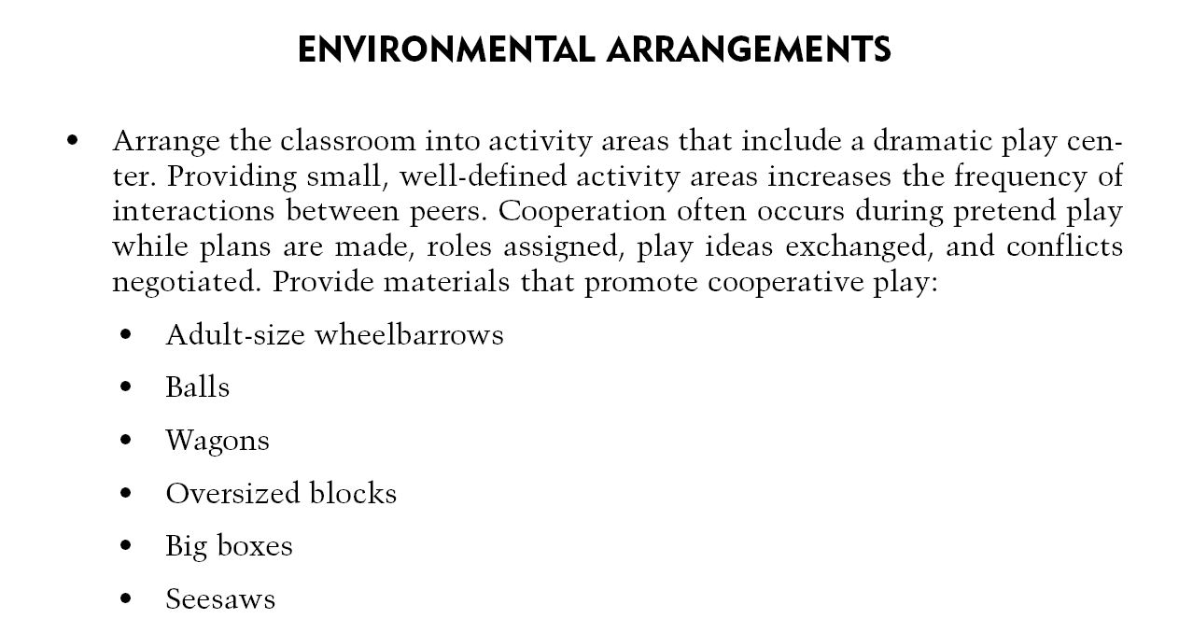
Notes:
92

Slide 93
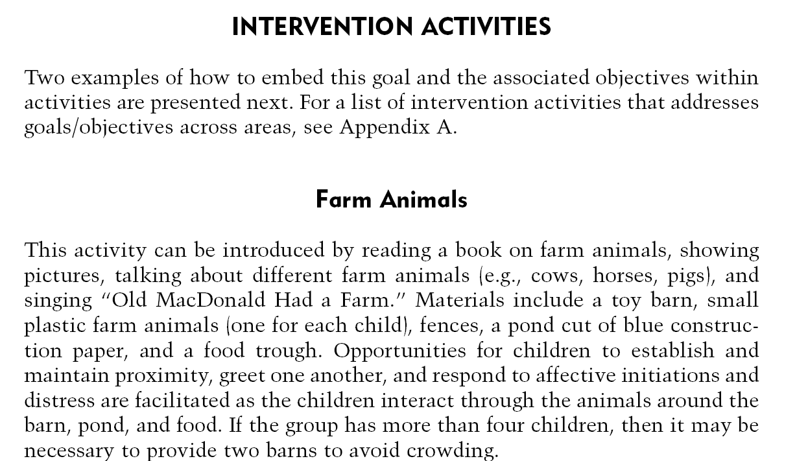
Notes:
93

Slide 94

DEC Assessment Practice Example
A24. Professionals assess not only immediate mastery of a skill, but also whether the child can demonstrate the skill consistently across other settings and with other people.
What does A24 look like?
The team assesses the child’s ability to walk in the classroom, on the playground, to and from the car…..
and on the grass…..
Notes:
KPF
94

Slide 95
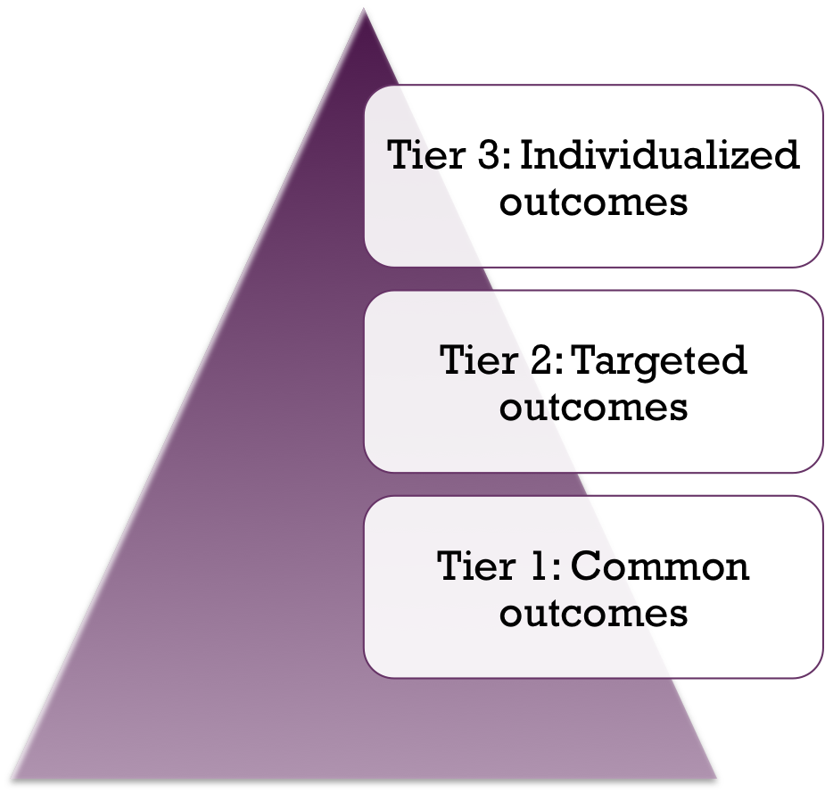
Example Class Profile
Task is to determine who needs to learn what and how best to instruct
Each child will have a different combination of needs
Notes:
KPF

Slide 96
Next Steps and Action Plan
Questions and answers
Where to go for assistance in the future
Develop an action plan
Notes:
Action Plan (HO)
Make sure participants have closure on any lingering questions and/or parking lot statements. If you don’t know the answer be sure to create a plan for getting a timely response back to participant(s).
Provide either Dr. Kristie Pretti-Frontcak’s e-mail if there are questions about the AEPS that exceed your knowledge (e.g., questions related to research and other uses).
Develop an Action Plan (as individuals or as teams). They can turn in a copy of their action plan or share with a colleague so there is some external accountability.

Slide 97
Communication in Detail

Slide 98
Purpose of the
Social Communication Area
Primary method of communication
Starting place is determined
Function
Sound production patterns
Intelligibility level
Notes:
Chapter 3 of Volume 1 providers more support regarding how to complete the Social Communication Observation Form (SCOF) and Social Communication Summary Form (SCSF).

Slide 99
Modes of Communication
Communication consists of three areas:
  Content - the meaning expressed through language
  Form - the syntax and grammar of language
  Use - the function of communication in social contexts
Messages are communicated through:
  Sounds
  Gestures

Slide 100
AEPS Data Recording Forms
Social-Communication Data Recording Form
Social-Communication Observation Form
Social-Communication Summary Form
Notes:
Review the SCOF and SCSF with participants and make the link between the information that is recorded and summarized and how to score Strand B and D of the Social Communication area.

Slide 101
Social-Communication Area
Strands Level I
Strand A - Prelinguistic Communications
Strand B - Transition to Words
Strand C - Comprehension of Words and Sentences
Strand D - Production of Social-Communicative Signals, Words and Sentences
Notes:
SCOF and SCSF (or scratch pieces of paper) are helpful in scoring and interpreting Strand B and D of the Social Communication Area.
Trainers should have a clear understanding of how item criteria may need to be modified for children who are using sign language or communication devises.
Trainers should have a clear understanding of how children who are bilingual should be scored across AEPS Test items. Keep in mind the AEPS is about function, but a child has to function in environments where both language may not be spoken or understood.

Slide 102
Communicative Signals
How does a child communicate?
Gestures - pointing, nodding, reaching
Vocalizations - sounds that are not conventional words
Vocalizations with Gestures - vocalization and gesture at the same time

Slide 103
Communicative Signals Continued
Did you understand the child’s attempt to communicate?
  Interpretable
  Partially interpretable
  Not interpretable

Slide 104
Communicative Function
Why did the child communicate?
  To gain attention (request)
  To respond to a question
  To refer to an object or person (comment)
  To greet someone
  To protest or refuse

Slide 105
Conducting
Language Observations
Communicative atmosphere
Be familiar with the child
Across time, activities and people
Observe or interact
Verbatim with paper and pencil or audio/video tape

