Slide 1
Lesson Planning
Sophie Hubbell
Kent State University
Presented October 19, 2009
Notes:
START the video tape!
Most of you already have your early childhood licenses and I believe all of you have had previous coursework of some kind related to lesson planning (curriculum class, literacy classes etc.) So I want to start by hearing what you already know about lesson planning. I thought it would be fun to use an evidence-based teaching strategy that is commonly used in preschool-elementary settings, The KWL chart.
KWL reference
BEFORE CLASS
Bring dry erase markers
Get Video camera
Draw KWL chart on the board

Slide 2
KWL Chart
What do you know about lesson planning?
What do you want to know about lesson planning?
What did you learn about lesson planning?
What questions do you still have?

Slide 3
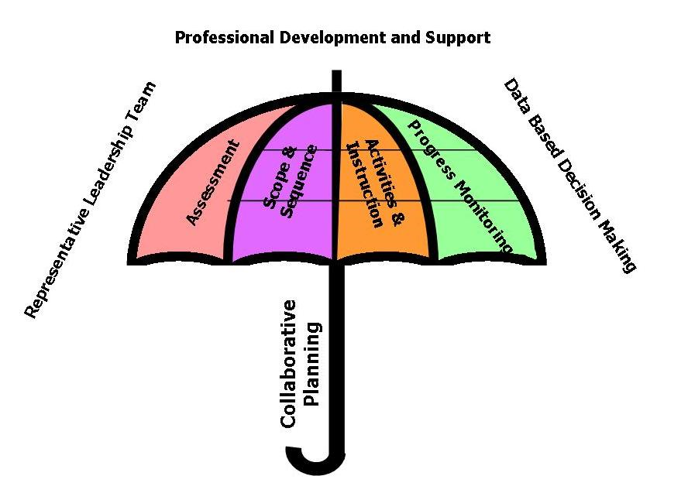
Curriculum framework
Notes:
Lesson planning related to the curriculum framework – where it fits in terms of scope and sequence and progress monitoring
Tiered model applies to instruction, progress monitoring, and scope and sequence.

Slide 4
Things to Consider
Planning interventions for individuals and planning whole class activities
Evidence-based practices versus evidence-based programs
Embedded interventions

Slide 5
Lesson planning templates
Ohio Department of Education
Bricker and Cripe (1992)
Grisham-Brown, Hemmeter, Pretti-Frontczak (2005)
More Examples
  Weekly plan
  Daily plan
  Activity plan
Notes:
Handouts and links in vista

Slide 6
Example
A literacy lesson plan at the emergent level (PreK/K)
Notes:
See Handout

Slide 7
Lesson Planning Process
Choose a place to start
Determine goals
Research EB practices
Link to students, standards, and/or theme
Develop plan details
Gather materials
Trial run, if necessary
Collect data/assess students
Design additional, related learning experiences or move on
Notes:
Choose a place to start: student data, curriculum standards, curriculum sequence, theme
Determine goals (general for class and specific child IEP-related)
Research EB practices – see resources at the end of this presentation which will also be posted in vista
Link to students, standards, sequence, theme (minus whatever you started with)
Develop plan including instruction, activities, assessment
Gather materials
Trial run if necessary- especially technology and science demonstrations, read read-alouds ahead of time
Collect data/Assess students to determine effectiveness of meeting original goals
Design additional experiences to meet deficits identified through assessment or move on to new objective/topic/theme/standard…

Slide 8
Complete a lesson plan together
Choose topic, goal, theme, or standard
Locate evidence-based practices online
Draft lesson plan
Notes:
If time, students complete a lesson/activity plan together as a group during class

Slide 9
Revisit KWL chart
What have you learned about lesson planning?
What questions do you still have about lesson planning?
Notes:
Record questions to answer in vista and/or provide additional resources in vista

Slide 10
Resources
http://ims.ode.state.oh.us/ODE/IMS/Lessons/Default.asp Ohio standards based lesson planning
http://www.literacycollaborative.org/research/findings/ evidence of LC as effective instruction
http://www.cec.sped.org/AM/Template.cfm?Section=CEC_Today1&TEMPLATE=/CM/ContentDisplay.cfm&CONTENTID=6515
http://www.ode.state.oh.us/GD/Templates/Pages/ODE/ODEDetail.aspx?page=3&TopicRelationID=1698&ContentID=1629&Content=73264 Ohio content standards
http://www.dec-sped.org/Professionals/Recommended_Practices
http://www.naeyc.org/research/otherresources see printout
http://www.promisingpractices.net/programs.asp
http://www.nectac.org/topics/evbased/evbased.asp
Notes:
Provide additional resources online in vista as needed.

