Slide 1
Response to Intervention
Sophia Hubbell
Kent State University
October 27, 2009

Slide 2
Response to Intervention
~ 5%
Tier 3
Tier 2
~15%
Tier 1
~ 80%
Notes:
Response to intervention (or RtI) is a tiered framework that defines both instruction and assessment practices. Environmental arrangement or set-up is also included as a component of instruction at all tiers. RTI applies to both academics and behavior.

Slide 3
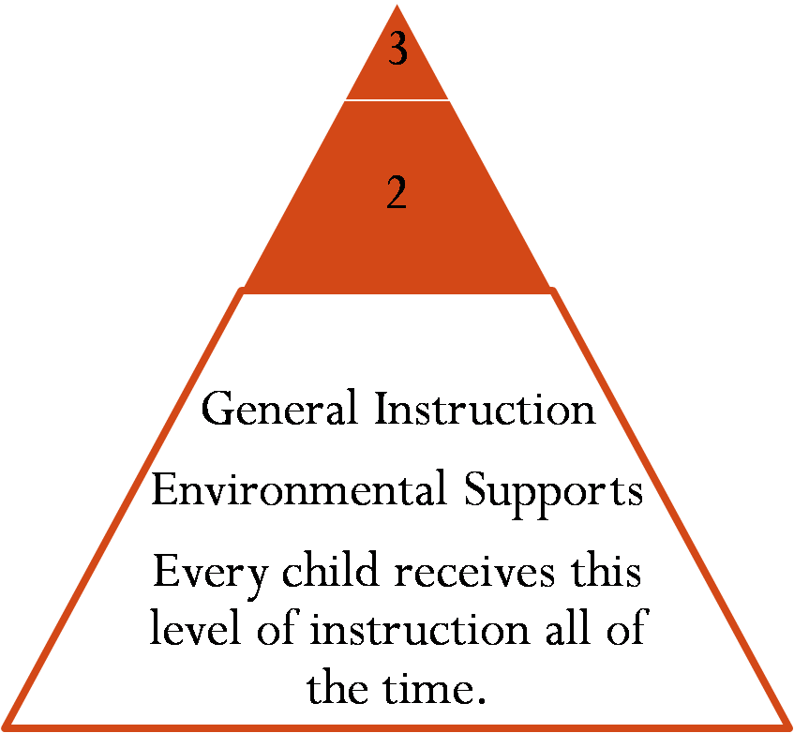
Tier 1
Notes:
At the base of the RTI pyramid, is general school-wide and classroom-wide instruction and assessment. This includes how you set-up your classroom, your classroom behavior management plan, general instruction that you provide to all students, and classroom and school-wide assessments.

Slide 4
Tier 2
3
Small group and/or individual support
Tier 1
Notes:
If a student is not making adequate progress in tier 1, the child would be moved to tier 2 for additional supports. Tier two interventions can be provided individually or in small groups depending on the needs of students. For example, if a child is not making adequate progress in reading and he normally receives small group instruction in reading 3 days per week. You could simply increase the meetings of that reading group to 5 days per week until he or the group reaches grade level target performance.

Slide 5
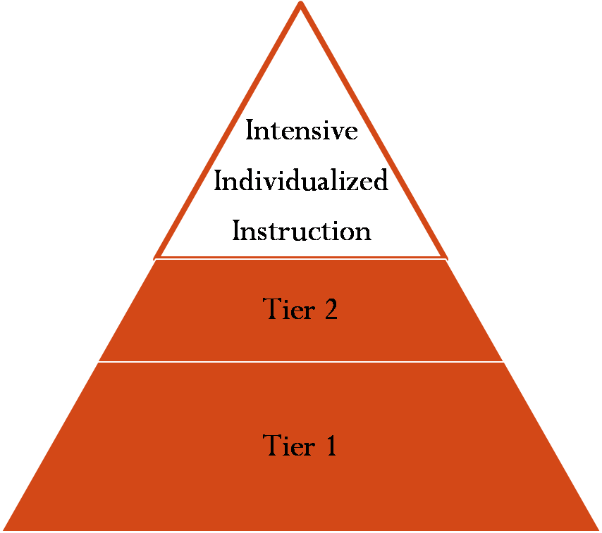
Tier 3
Notes:
If the child continues to make inadequate progress at tier 2, then he would be moved to tier 3. In tier 3, children receive intensive individualized intervention. Using the reading example again, this could be the general education teacher puling one student for a 10 minute intervention daily during literacy centers.

Slide 6
Adding Tiers
Changes are fluid and frequent
Tiered instruction is cumulative.
Adequate progress defined by districts.
Notes:
The tiers are fluid, meaning students can move in and out of them. They are also cumulative. One student may receive tier 2 in reading, but be in tier 1 for everything else one week, and next month he may be in tier 3 for math and tier 1 for everything else. When a student is receiving tier 2 interventions he continues to receive tier one as well. (Flexible groupings as in best practices for reading instruction)
Adequate progress will be defined by your district or school. Generally, it is meeting the grade-level expectation for a skill.

Slide 7
Evidence-Based Practices
All interventions and environmental supports should be based in well-research practices that have been proven effective.
Notes:
All of the practices implemented in all of the tiers should be evidence-based. The foundation of this model is that all children receive excellent general instruction that has been proven effective through research. The underlying belief is that all children can learn and make progress when provided with good general instruction and individualized modifications as needed.

Slide 8
Data Collection
Assessment increases with the intensity of interventions.
Assessment practices are cumulative.
Notes:
In order for the RTI model to be effective, teachers must regularly collect data about student performance (which is also called progress monitoring). As a child moves up in the tiers the frequency of assessment increases with the intensity of the intervention.

Slide 9
Who is responsible?
General education teachers are usually responsible for RtI implementation.
District practices vary.
Potential teacher supports: intervention specialists, tutors, content area specialists, related service providers
State Support Teams
Notes:
Who provides the services- instruction and assessment, vary depending on district and building resources. In some districts, personnel are available to help teachers with progress monitoring through use of school wide DIBELS assessments (or something similar) and/or regular CBM’s (curriculum-based measurement) in your classroom). Primarily the general education teacher is responsible, but others could be involved including intervention specialist, tutor, content area specialists (e.g. reading or math), related service providers, even your administrator.

Slide 10
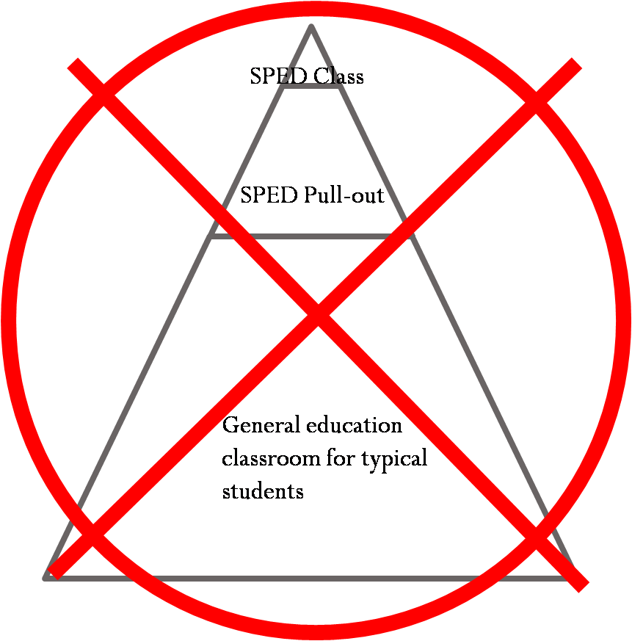
RTI and Special Education is NOT
Notes:
The tiers DO NOT equate to special education. Sometimes people confuse rti tiers with special education “LRE” or least restrictive environments. Provide visual with red X- Next slide sped rti pyramid within tier 1 of general pyramid.
IDEA 2004 gives the option of using RTI as a component of eligibility determination for students with specific learning disabilities.

Slide 11

RTI and Special Education IS
General Education Classroom
IEP Supports for an Individual

Slide 12
Resources and References
State Support Teams, Region 8
  http://cybersummit.org/sst/
Center for RTI in Early Childhood (CRTIEC)
  www.crtiec.org
National Center on Response to Intervention
  www.rti4success.org
National Center on Student Progress Monitoring
  http://www.studentprogress.org/default.asp
OSEP Technical Assistance Center on Positive Behavioral Interventions & Supports
  http://www.pbis.org/

